Slide 1
UNIT V NEURAL NETWORKS AND TYPES OF LEARNING 9+6
Biological Neuron – Artificial Neuron – Types of Activation function – Implementations of ANN – Architectures of Neural Networks – Learning Process in ANN – Back propagation – Deep Learning – Representation Learning – Active Learning – Instance based Learning – Association Rule Learning – Ensemble Learning Algorithm – Regularization Algorithm- Reinforcement Learning – Elements Model-based- Temporal Difference Learning

Slide 2
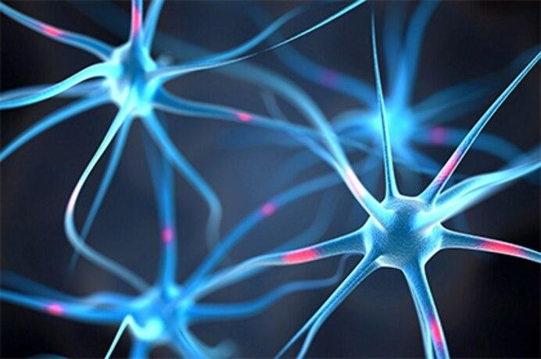
Neural Networks
Neural Networks are networks of interconnected neurons, for example in human brains.
Artificial Neural Networks are highly connected to other
neurons, computations
and performs by combining
signals from other neurons.
Outputs of these computations may be transmitted to one or more other neurons.
The neurons are connected together in a specific way to perform a particular task.

Slide 3
Artificial Neural Networks (High-Level Overview)
A neural network is a function.
It consists of basically:
Neurons: which pass input values through functions and output the result.
Weights: which carry values ( real-number) between neurons.
•
Neurons can be categorized into layers:
Input Layer
Hidden Layer
Output Layer

Slide 4
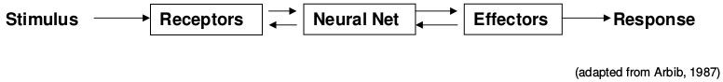
Neurophysiology
The human nervous system can be divided into three stages:
Receptors:
Convert stimuli from the external environment into electrical impulses
Rods and Cones of eyes,
Pain, touch, hot and cold receptors of skin.
Neural Net:
Receive information, process it and make appropriate decisions.
Brain
Effectors:
Convert electrical impulses generated by the the neural net (brain) into responses to the external environment.
Muscles and glands, speech generators.

Slide 5
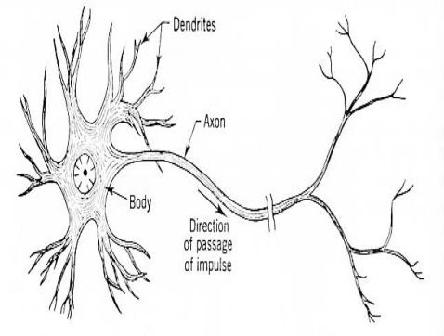
Basic Components of Biological Neurons
The basic components of a biological neuron are:
Cell Body (Soma) processes the incoming activations and converts them into output activations.
Neuron Nucleus contains the genetic material (DNA).
Dendrites form a fine filamentary bush each fiber thinner than an axon.
Axon: Long thin cylinder carrying impulses from soma to other cells
Synapses: The junctions that allow signal transmission b/w the axons and dendrites.

Slide 6
Computation in Biological Neurons
Incoming signals from synapses are summed up at the soma.
On crossing a threshold, the cell fires generating an action potential in the axon hillock region.

Slide 7
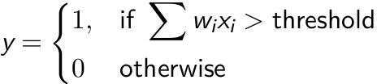
The Perceptron Model
Motivated by neuron.
A perceptron
the biological
x
w₁
is a computing
1
element where inputs are associated with the weights and the cell having a threshold value.
w₂
y
x
2
x
n
w_{n}

Slide 8
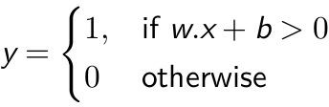
The Perceptron Model
Rewrite Σ w_{i} x_{i} as w.x
Replace
b: Bias, a prior inclination towards some decision.
x
1
threshold = -b
w₁
x
2
w₂
y
x
n
w_{n}

Slide 9
A simple decision via Perceptron
Whether should you go to watch
x
movie this weekend?
The decision variables are:
w₁
1
Is there any extra lecture this weekend? (x₁)
Does your friend want to go with you? (x₂)
w₂
y
x
2
x
n
w_{n}
Do you have assignments due weekend? (x₃)
pending on the

Slide 10
A simple decision via Perceptron
Whether should you go to watch
movie this weekend?
The decision variables are:
x
1
b= -8
5
Is there any extra lecture this weekend? (x₁=1)
Does your friend want to go with you? (x₂=0)
3
0
x
2
x
3
2
Do you assignments
have pending due on the
weekend? (x₃=1)

Slide 11
A simple decision via Perceptron
Whether should you go to watch
movie this weekend?
The decision variables are:
x
1
b= -3
5
Is there any extra lecture this weekend? (x₁=1)
Does your friend want to go with you? (x₂=0)
3
1
x
2
x
3
2
Do you assignments
have pending due on the
weekend? (x₃=0)

Slide 12
Emulating Logical Gates with Perceptron
x₁
5
x₁
5
OR
AND
-2
-6
x₂
x₂
3
3
x₁
-5
NOT
-3
NAND
6
x
2
1
x₂
-3

Slide 13

Perceptron Training
Step-1: Absorb bias b as weight.
x
Step-2: Start with a random value of weight w_{j}
Step-3: Predict for each input x_{i} :
If the prediction is correct ∀x, then Return w
Step-4: On a mistake for given input x
, update as follows:
w₁
1
x
2
w₂
y
x
n
w_{n}
Mistake on positive (y=1), update w_{j+1}⬅ w_{j} + x
Mistake on negative (y=0), update w_{j+1}⬅ w_{j} - x
14

Slide 14
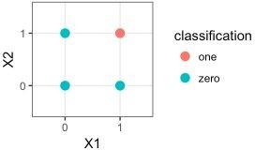
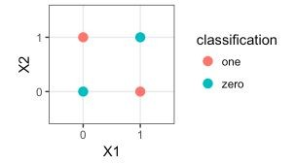
Convergence of Perceptron Training
AND XOR
Whatever be the initial choice of weights and whatever be the input vector, PTA converges if the vectors are from a linearly separable function.
If the weight repeats while training the perceptron, then the function is
not linearly separable.

Slide 15
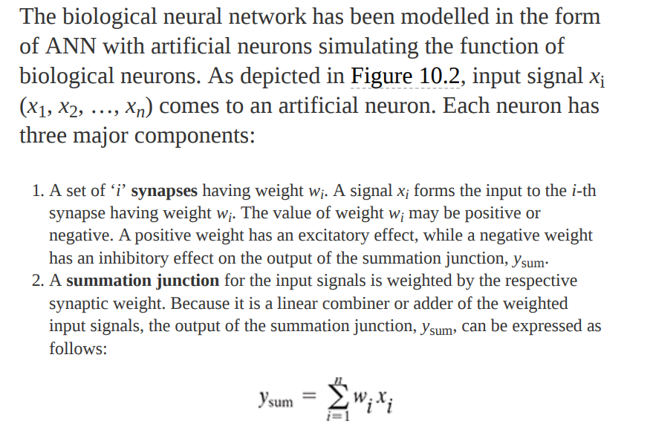
EXPLORING THE ARTIFICIAL NEURON

Slide 16
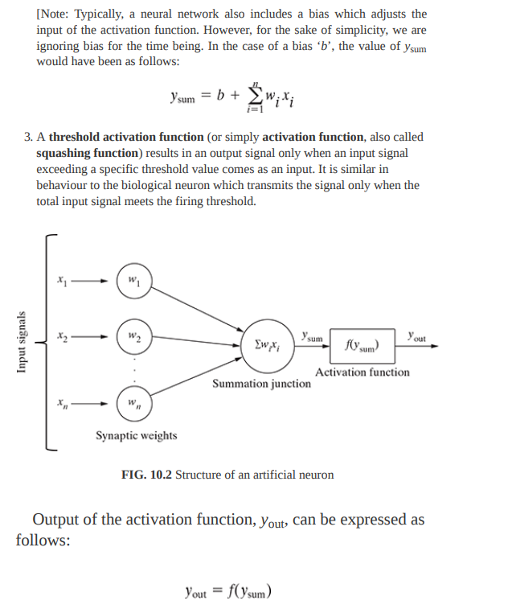

Slide 17
Activation Functions
Activation function decide whether a neuron should be activated or not.
It helps the network to use the useful information and suppress the irrelevant information.
Usually a nonlinear function.
What if we choose a linear?
Linear classifier
Limited capacity to solve complex problems.

Slide 18
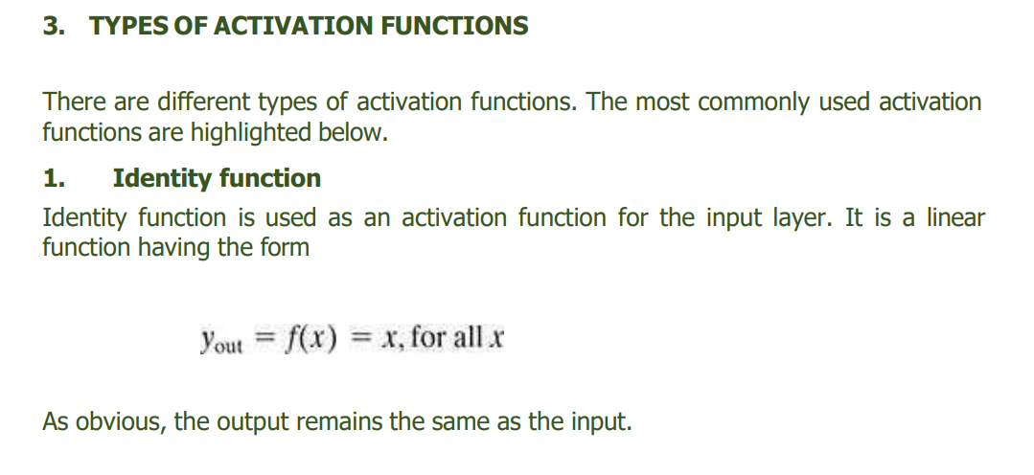

Slide 19
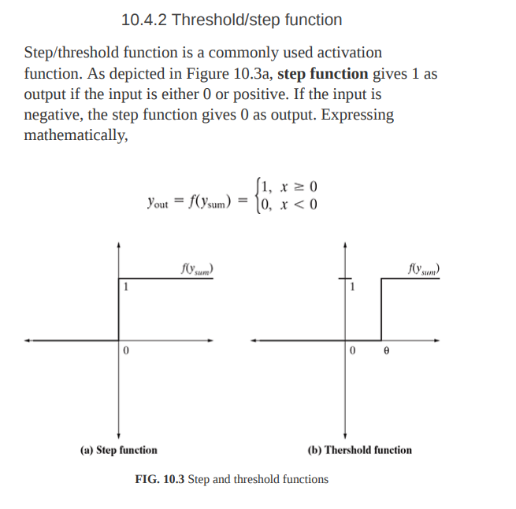

Slide 20
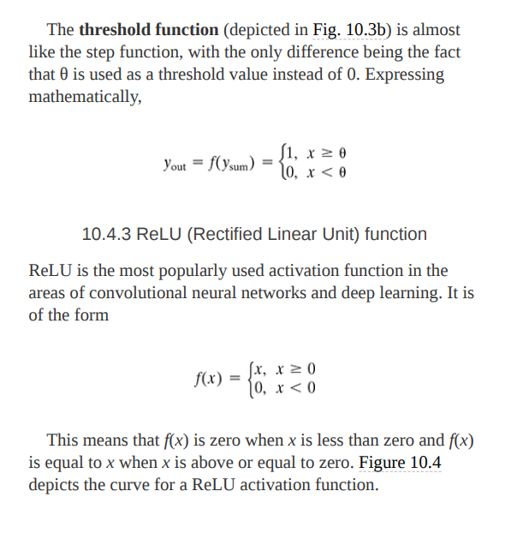

Slide 21
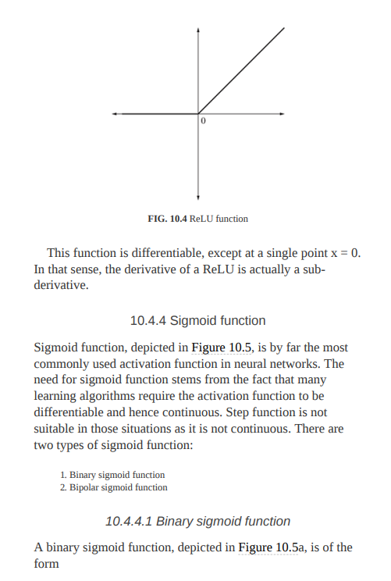

Slide 22
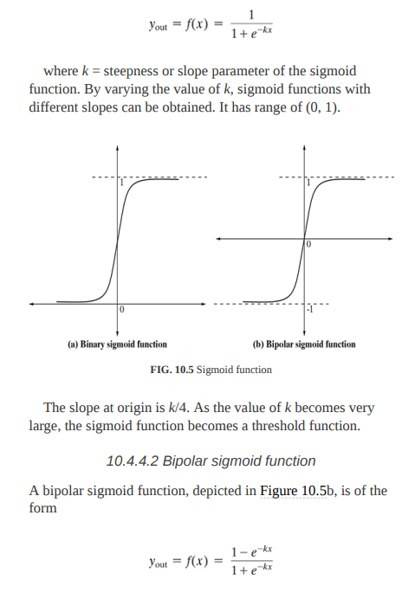
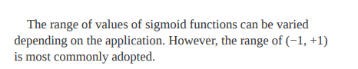

Slide 23
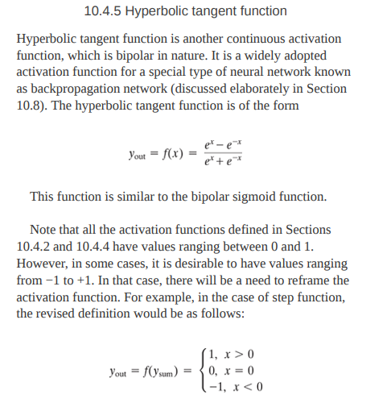

Slide 24
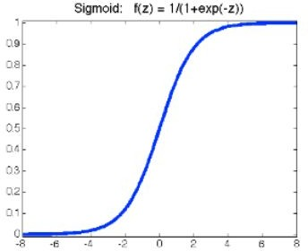
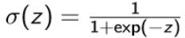
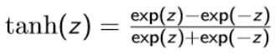
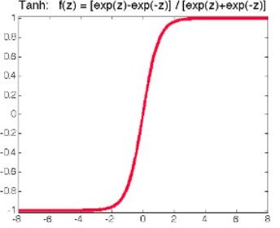
Activation Functions (cont’d)
Sigmoid
continuously differentiable
ranges from 0-1
not symmetric around the origin
Tanh
○
○
scaled version of the sigmoid
symmetric around the origin
vanishing gradient

Slide 25
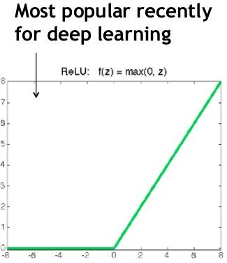
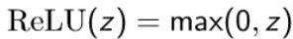
Activation Functions (cont’d)
ReLU
Also called piecewise linear function because rectified function is linear for half of the input domain and nonlinear for the other half.
trivial to implement
sparse representation
avoid the problem of vanishing gradients
dead neurons

Slide 26
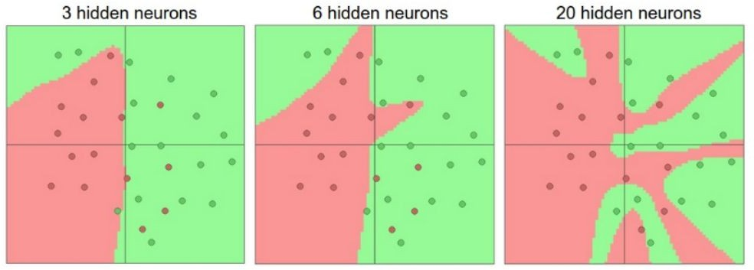
Representation Power
A neural network with at least one hidden layer can approximate any function.[1]
The representation power of network increase with more hidden units
and more hidden layers.
But, “with great power comes great overfitting”
●
[1] Cybenko, George. "Approximation by superpositions of a sigmoidal function." Mathematics of control, signals and systems 2.4 (1989): 303-314.

Slide 27
UNIT V NEURAL NETWORKS AND TYPES OF LEARNING 9+6
Biological Neuron – Artificial Neuron – Types of Activation function – Implementations of ANN – Architectures of Neural Networks – Learning Process in ANN – Back propagation – Deep Learning – Representation Learning – Active Learning – Instance based Learning – Association Rule Learning – Ensemble Learning Algorithm – Regularization Algorithm- Reinforcement Learning – ElementsModel-based- Temporal Difference Learning

Slide 28
IMPLEMENTATIONS OF ANN
1 McCulloch–Pitts model of neuron
2 Rosenblatt’s perceptron
2.1 Multi-layer perceptron
3 ADALINE network model

Slide 29
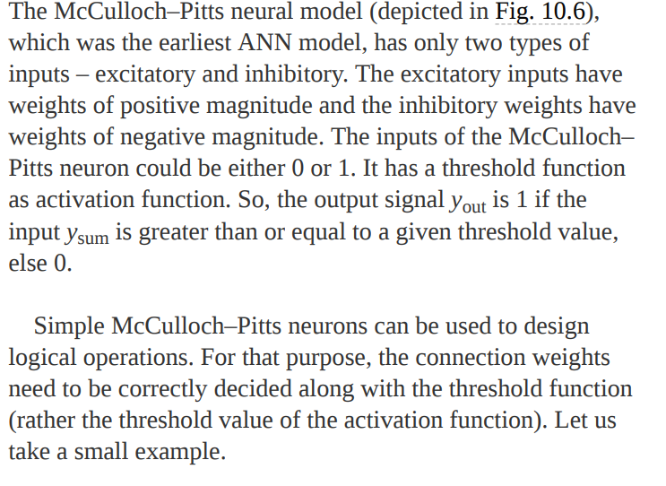



1 McCulloch–Pitts model of neuron

Slide 30
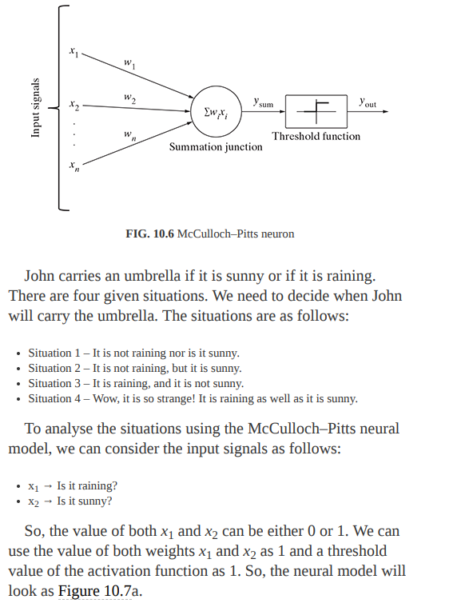

Slide 31
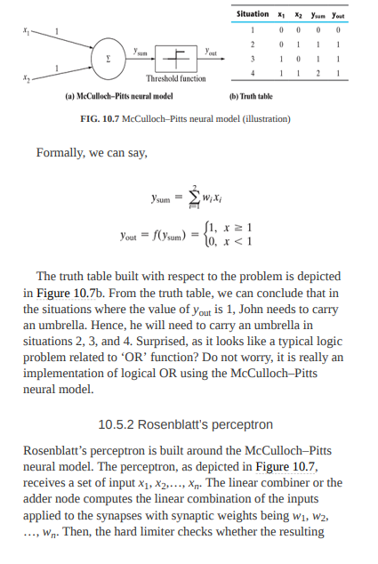





Slide 32
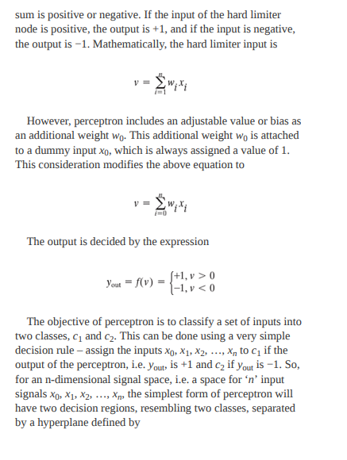


Slide 33
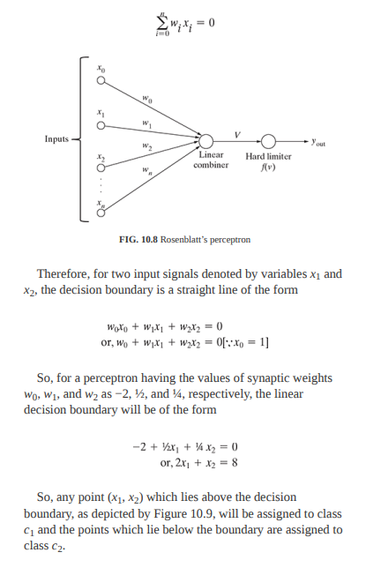

Slide 34
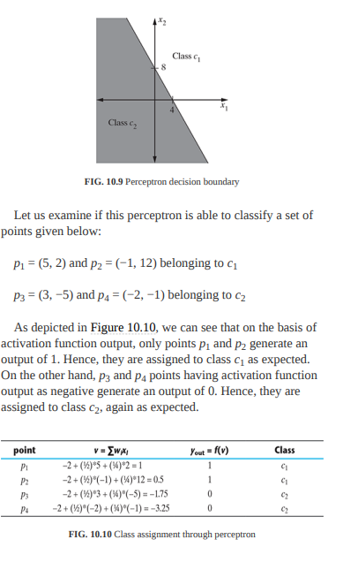

Slide 35
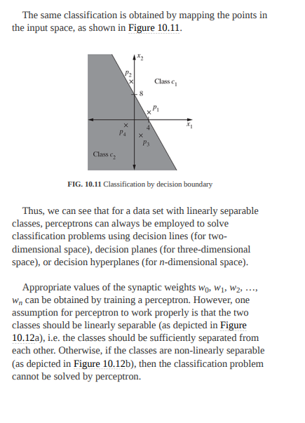

Slide 36
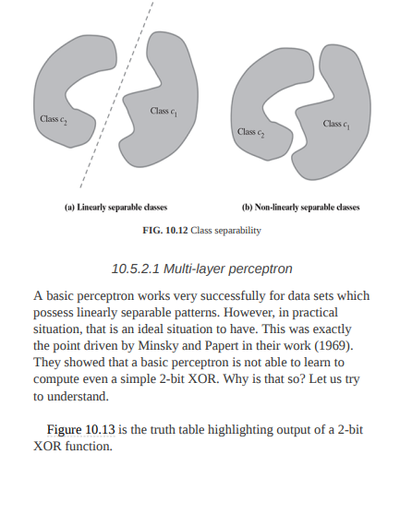

Slide 37
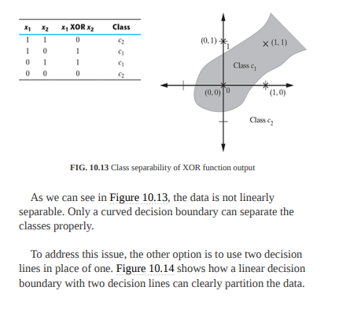

Slide 38
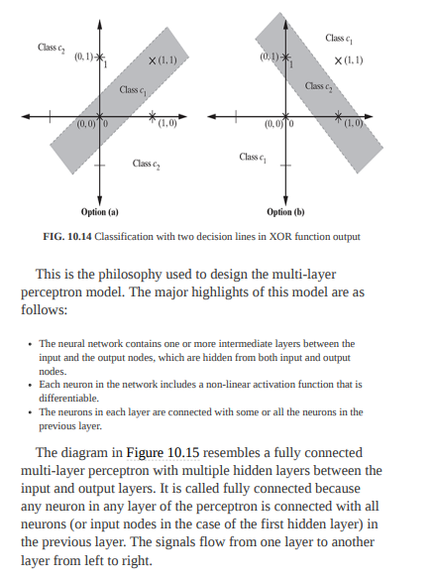

Slide 39
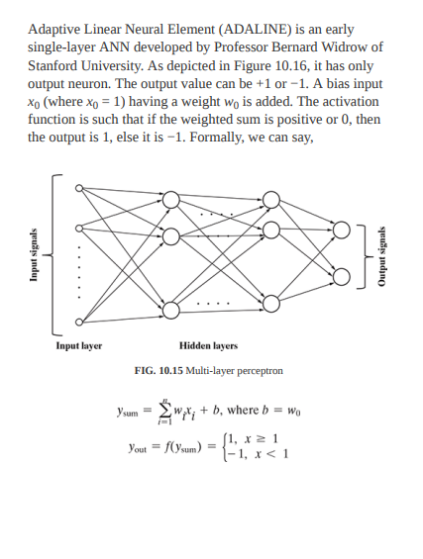
ADALINE network model

Slide 40
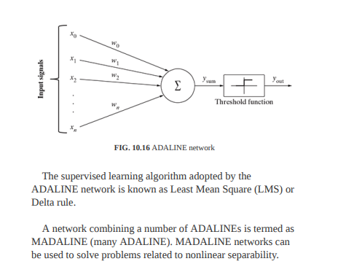

Slide 41
ARCHITECTURES OF NEURAL NETWORK
1.Single-layer feed forward Network
.2 Multi-layer feed forward ANNs
3 Competitive network

Slide 42
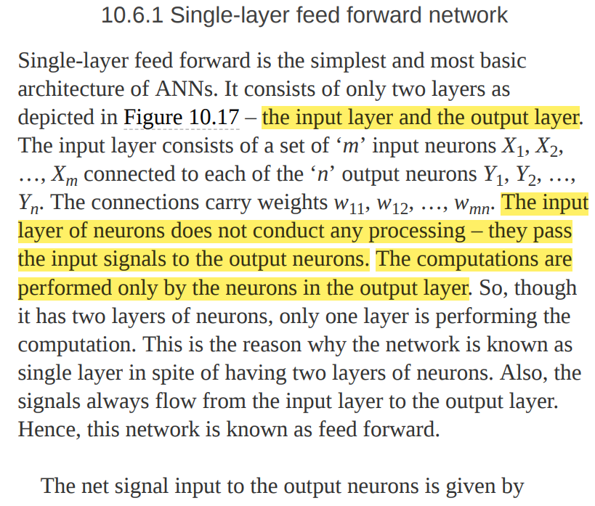

Slide 43
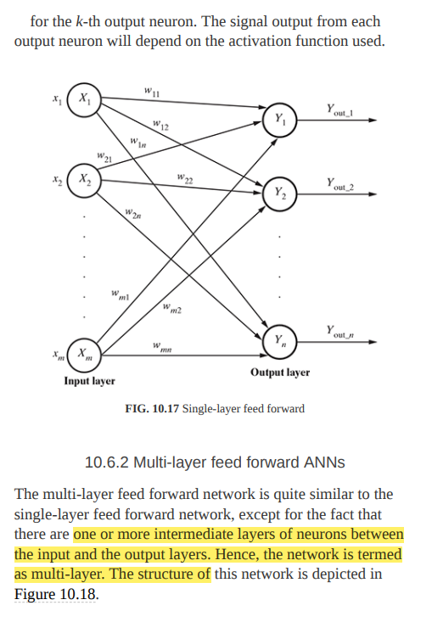

Slide 44
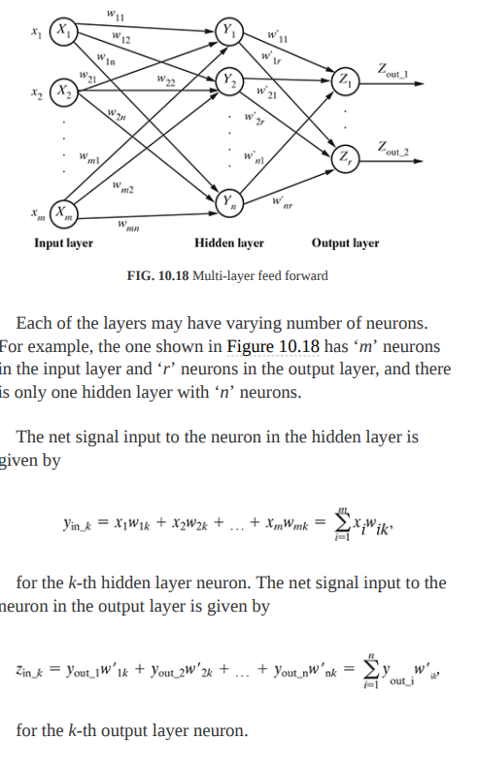

Slide 45
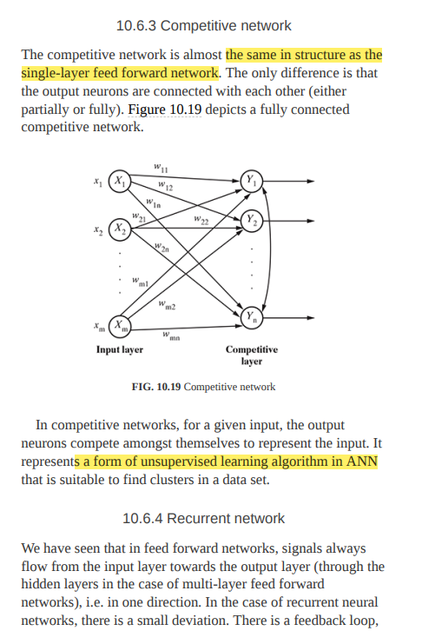

Slide 46
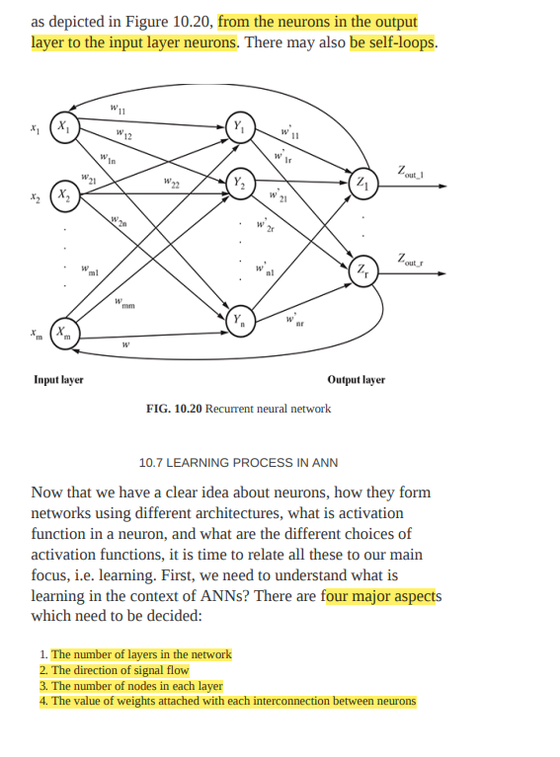

Slide 47
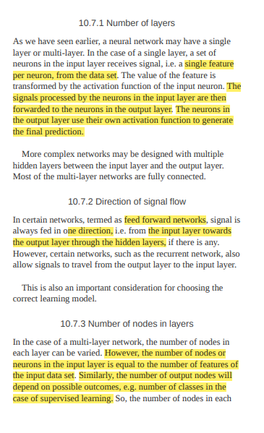

Slide 48
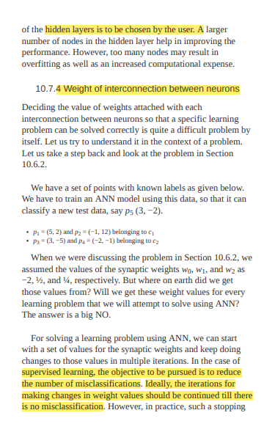

Slide 49
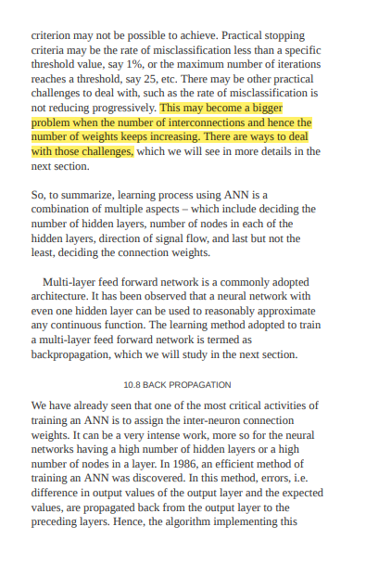

Slide 50
UNIT V NEURAL NETWORKS AND TYPES OF LEARNING 9+6
Biological Neuron – Artificial Neuron – Types of Activation function – Implementations of ANN – Architectures of Neural Networks – Learning Process in ANN – Back propagation – Deep Learning – Representation Learning – Active Learning – Instance based Learning – Association Rule Learning – Ensemble Learning Algorithm – Regularization Algorithm- Reinforcement Learning – ElementsModel-based- Temporal Difference Learning

Slide 51
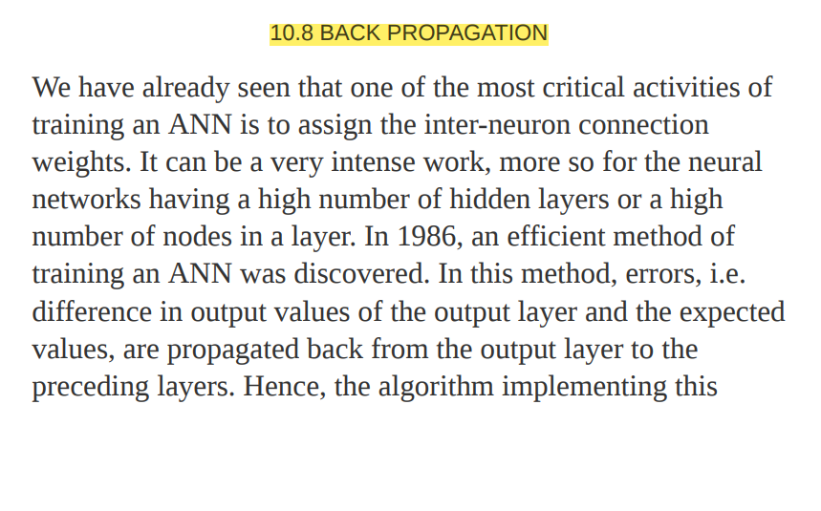

Slide 52
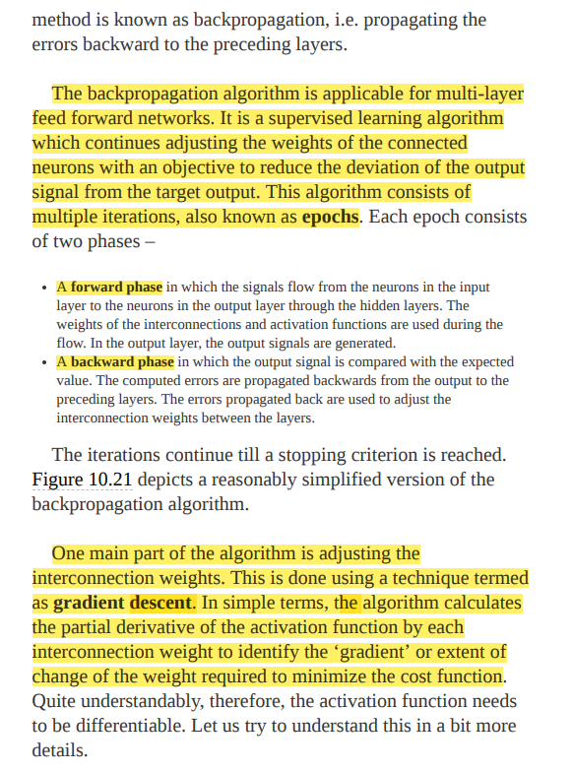

Slide 53
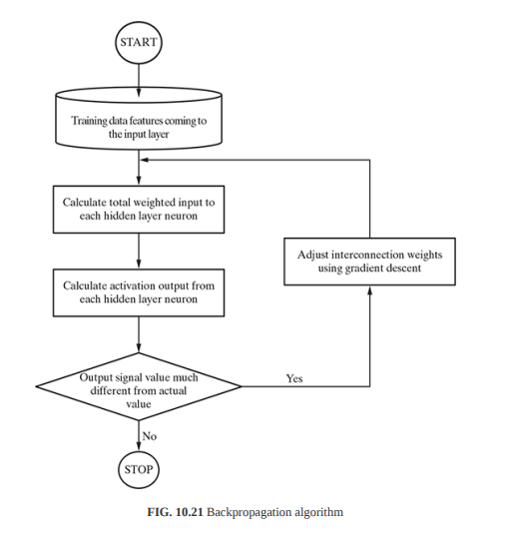

Slide 54
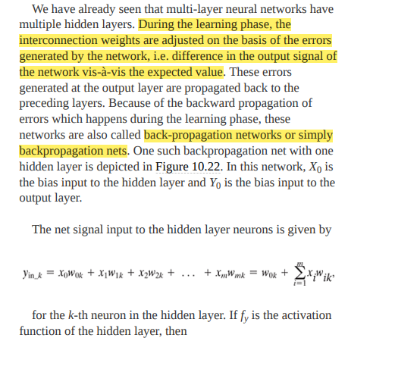

Slide 55
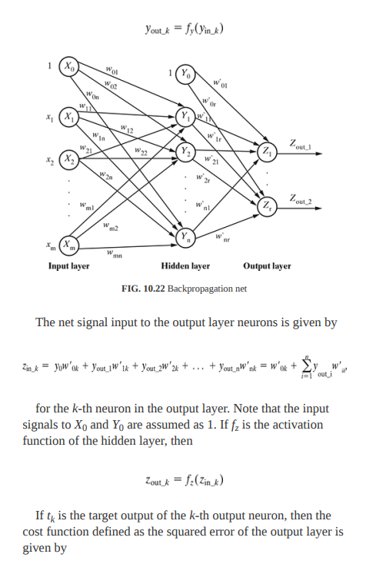

Slide 56
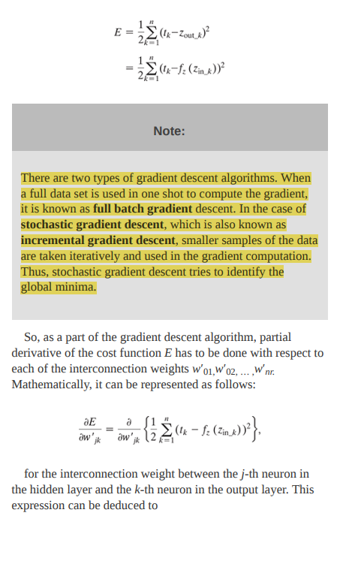

Slide 57
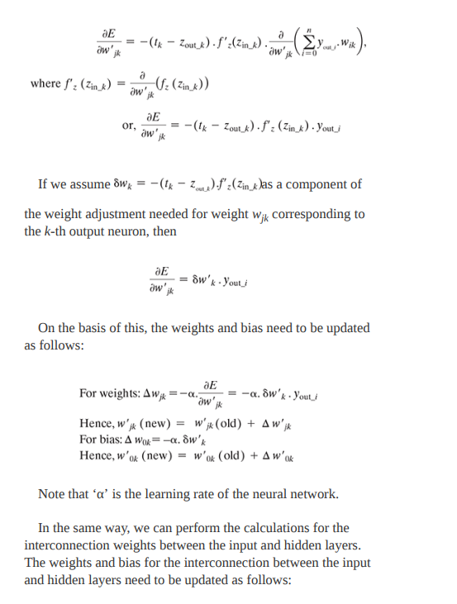

Slide 58


Slide 59
DEEP LEARNING
. Going beyond two to three layers becomes quite difficult computationally. The only way to handle such intense computation is by using graphics processing unit (GPU) computing. When we have less number of hidden layers – at the maximum two to three layers, it is a normal neural network, which is sometimes given the fancy name ‘shallow neural network’. However, when the number of layers increases, it is termed as deep neural network. One of the earliest deep neural networks had three hidden layers. Deep learning is a more contemporary branding of deep neural networks, i.e. multilayer neural networks having more than three layers.

Slide 60

Multi-layer perceptrons
To make nonlinear classifiers out of perceptrons, build a multi-layer neural network!
This requires each perceptron to have a nonlinearity

Slide 61
Multi-layer perceptrons
To make nonlinear classifiers out of perceptrons, build a multi-layer neural network!
This requires each perceptron to have a nonlinearity
To be trainable, the nonlinearity should be differentiable
1
Sigmoid:
g(t) =
Rectified linear unit (ReLU): g(t) = max(0,t)
1+ e^{−t}

Slide 62
Training of multi-layer networks
Find network weights to minimize the prediction loss between true and estimated labels of training examples:
𝐸 𝐰 = $ 𝑙(𝐱_{i}, 𝑦_{i}; 𝐰)
i
Possible losses (for binary problems):
Quadratic loss: 𝑙 𝐱_{i}, 𝑦_{i}; 𝐰 = 𝑓_{𝐰}(𝐱_{i}) − 𝑦_{i} ²
Log likelihood loss: 𝑙 𝐱_{i}, 𝑦_{i}; 𝐰 = −log 𝑃_{𝐰} 𝑦_{i} | 𝐱_{i}
Hinge loss: 𝑙 𝐱_{i}, 𝑦_{i}; 𝐰 = max(0,1 − 𝑦_{i}𝑓_{𝐰} 𝐱_{i} )

Slide 63


Feed-forward Neural Network
a₁
x₁
a₂
y₁
x₂
a₃
y₂
x₃
a₄
Hidden
Input
Output

Slide 64

Objective Function
The function we want to minimize or maximize is called the objective function or criterion.
When we are minimizing it, we may also call it the cost function, loss function, or error function.
A loss function tells how good our current classifier is.
Given a dataset:

Slide 65

Objective Function (cont’d)
Mean Squared Error:
Mean Squared Error (MSE), or quadratic, loss function is widely used in linear regression as the performance measure.
It measures the average of the squares of the errors—that is, the average squared difference between the estimated values and the actual value.
It is always non-negative, and values closer to zero are better.

Slide 66

Objective Function (cont’d)
Mean Absolute Error:
Mean Absolute Error (MAE) is a quantity used to measure how close forecasts or predictions are to the eventual outcomes.
Both MSE and MAE are used in predictive modeling.
MSE has nice mathematical properties which makes it easier to compute the gradient.

Slide 67

Objective Function (cont’d)
Cross-entropy:
Coss-entropy comes from the field of information theory and has the unit of “bits.”
The cross-entropy between a “true” distribution p and an estimated distribution q is defined as:
Cross-entropy can be re-written in terms and Kullback-Leibler divergence between the
of the entropy two distributions

Slide 68

Objective Function (cont’d)
Cross-entropy:
Assuming a ground truth probability distribution that is 1 at the right class and 0 everywhere else p = [0,…,0,1,0,…0] and our computed probability is q
Kullback-Leibler divergence can be written as:

Slide 69
Backpropagation Algorithm
Backpropagation algorithm is used to train artificial neural networks, it can update the weights very efficiently.
It is a computationally efficient approach to compute the derivatives of a complex cost function.
Goal is to use those derivatives to learn the weight coefficients for parameterizing a multi-layer artificial neural network.
It compute the gradient of a cost function with respect to all the weights in the network, so that the gradient is fed to the gradient descent method which in turn uses it to update the weights in order to minimize the cost function.

Slide 70









Backpropagation Algorithm (cont’d)
Chain Rule:
Single Path
x
y
z
Multiple Path
y
1
x
z
y
2
35

Slide 71

Backpropagation Algorithm (cont’d)
The total error in the network for a single input is given by the following equation
^{w}ij
^{w}jk
Input (i)
Hidden (j)
Output (k)

Slide 72

Backpropagation Algorithm (cont’d)
There are two sets of weights in our network:
^{w}ij
^{w}jk
w_{ij} : from the input to the hidden
layer.
w_{jk} : from the hidden to the output
layer.
We want to adjust the network’s
weights to reduce this overall error.
○
Input (i)
Hidden (j)
Output (k)

Slide 73

Backpropagation Algorithm (cont’d)
Backpropagation – for outermost layer
outermost layer parameters
^{w}ij
^{w}jk
directly affect the value of the error function.
only one summation
term of the E will have a the one
non-zero derivative:
Input (i)
Hidden (j)
Output (k)
associated with the particular weight we are considering.

Slide 74



Backpropagation Algorithm (cont’d)
Backpropagation – for outermost layer
^{w}ij
^{w}jk
Input (i)
Hidden (j)
Output (k)

Slide 75



Backpropagation Algorithm (cont’d)
Backpropagation – for outermost layer
^{w}ij
^{w}jk
Output (k)
Input (i)
Hidden (j)
For sigmoid activation function

Slide 76

Backpropagation Algorithm (cont’d)
Backpropagation – for hidden layer
^{w}ij
^{w}jk
Output (k)
Input (i)
Hidden (j)

Slide 77

Backpropagation Algorithm (cont’d)
Backpropagation – for hidden layer
^{w}ij
^{w}jk
Input (i)
Hidden (j)
Output (k)

Slide 78

Backpropagation Algorithm (cont’d)
Backpropagation – for hidden layer
^{w}ij
^{w}jk
Output (k)
Input (i)
Hidden (j)

Slide 79


Slide 80


Slide 81


Slide 82


Slide 83


Slide 84


Slide 85

REPRESENTATION LEARNING

Slide 86


Slide 87


Slide 88


Slide 89


Slide 90


Slide 91


Slide 92


Slide 93


Slide 94


Slide 95
Pros and cons of instance-based learning method
Advantage: Instance-based learning (IBL) methods are particularly well suited to problems where the target function is highly complex, but can also be defined by a group of not as much of complex local approximations. The
disadvantage I: The cost of classification of new instances can be high (a majority of the calculation takes place at this stage). Disadvantage II: Many IBL approaches usually study all characteristics of the instances leading to dimensionality-related problems.

Slide 96


Slide 97


Slide 98


Slide 99


Slide 100


Slide 101


Slide 102
Reinforcement Learning
Reinforcement learning is an area of Machine Learning. It is about taking suitable action to maximize reward in a particular situation. It is employed by various software and machines to find the best possible behavior or path it should take in a specific situation. Reinforcement learning differs from supervised learning in a way that in supervised learning the training data has the answer key with it so the model is trained with the correct answer itself whereas in reinforcement learning, there is no answer but the reinforcement agent decides what to do to perform the given task. In the absence of a training dataset, it is bound to learn from its experience.
Reinforcement Learning (RL) is the science of decision making. It is about learning the optimal behavior in an environment to obtain maximum reward. In RL, the data is accumulated from machine learning systems that use a trial-and-error method. Data is not part of the input that we would find in supervised or unsupervised machine learning.

Slide 103
Reinforcement learning uses algorithms that learn from outcomes and decide which action to take next. After each action, the algorithm receives feedback that helps it determine whether the choice it made was correct, neutral or incorrect. It is a good technique to use for automated systems that have to make a lot of small decisions without human guidance.
Reinforcement learning is an autonomous, self-teaching system that essentially learns by trial and error. It performs actions with the aim of maximizing rewards, or in other words, it is learning by doing in order to achieve the best outcomes.

Slide 104

Example:
The problem is as follows: We have an agent and a reward, with many hurdles in between. The agent is supposed to find the best possible path to reach the reward. The following problem explains the problem more easily.
The above image shows the robot, diamond, and fire. The goal of the robot is to get the reward that is the diamond and avoid the hurdles that are fired. The robot learns by trying all the possible paths and then choosing the path which gives him the reward with the least hurdles. Each right step will give the robot a reward and each wrong step will subtract the reward of the robot. The total reward will be calculated when it reaches the final reward that is the diamond. Main points in Reinforcement learning –
Input: The input should be an initial state from which the model will start
Output: There are many possible outputs as there are a variety of solutions to a particular problem
Training: The training is based upon the input, The model will return a state and the user will decide to reward or punish the model based on its output.
The model keeps continues to learn.
The best solution is decided based on the maximum reward.

Slide 105
Types of Reinforcement:
There are two types of Reinforcement:
Positive: Positive Reinforcement is defined as when an event, occurs due to a particular behavior, increases the strength and the frequency of the behavior. In other words, it has a positive effect on behavior. Advantages of reinforcement learning are:
Maximizes Performance
Sustain Change for a long period of time
Too much Reinforcement can lead to an overload of states which can diminish the results
Negative: Negative Reinforcement is defined as strengthening of behavior because a negative condition is stopped or avoided. Advantages of reinforcement learning:
Increases Behavior
Provide defiance to a minimum standard of performance
It Only provides enough to meet up the minimum behavior

Slide 106


Slide 107
Elements of Reinforcement Learning
Reinforcement learning elements are as follows:
Policy
Reward function
Value function
Model of the environment
Policy: Policy defines the learning agent behavior for given time period. It is a mapping from perceived states of the environment to actions to be taken when in those states.
Reward function: Reward function is used to define a goal in a reinforcement learning problem.A reward function is a function that provides a numerical score based on the state of the environment
Value function: Value functions specify what is good in the long run. The value of a state is the total amount of reward an agent can expect to accumulate over the future, starting from that state.
Model of the environment: Models are used for planning.

Slide 108
Credit assignment problem: Reinforcement learning algorithms learn to generate an internal value for the intermediate states as to how good they are in leading to the goal. The learning decision maker is called the agent. The agent interacts with the environment that includes everything outside the agent.
The agent has sensors to decide on its state in the environment and takes action that modifies its state.
The reinforcement learning problem model is an agent continuously interacting with an environment. The agent and the environment interact in a sequence of time steps. At each time step t, the agent receives the state of the environment and a scalar numerical reward for the previous action, and then the agent then selects an action.

